Slide 1


Rockwell Imachination
Manufacturing Optimization
Gino Maulini
Meiling He
Xiangyong Luo
Simon Vancina
Notes:
Mention team name, member names, locations and whether you are a Rockwell automation employee/contractor or external participant.
Suggested time: 15 seconds or less

Slide 2
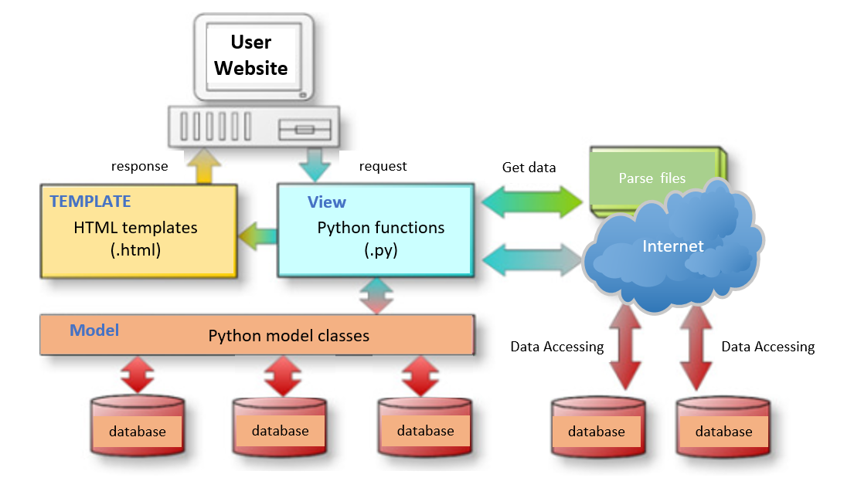
Approach To The Problem
Rockwell Imachination
Develop front-end
Build back-end framework
Create optimization strategy
Notes:
Use this slide to quickly discuss the approach that you took to solve the use case.
emphasize key points with formatting (bold, italics, underline… Whatever is best to get the point across.
Use this sparingly to maintain legibility.
Suggested time: 30 seconds

Slide 3
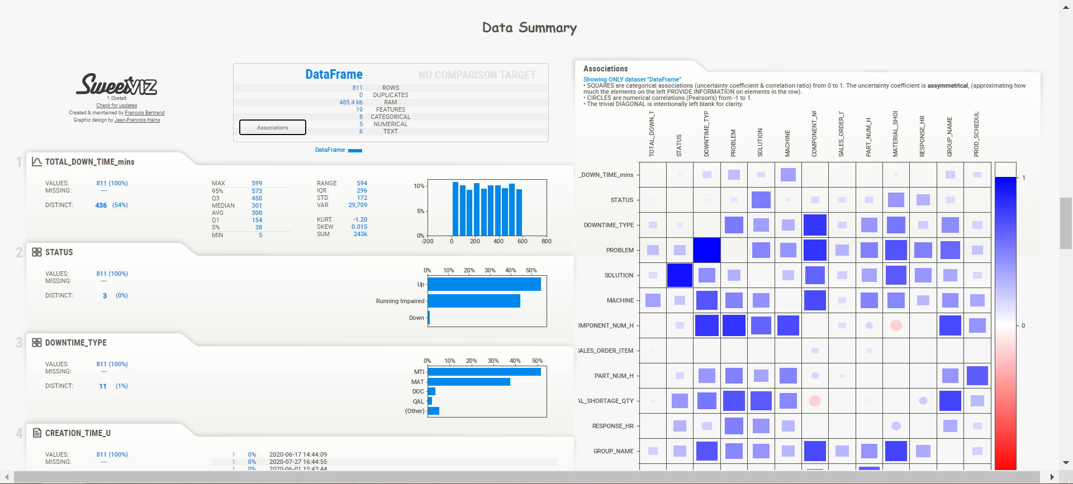
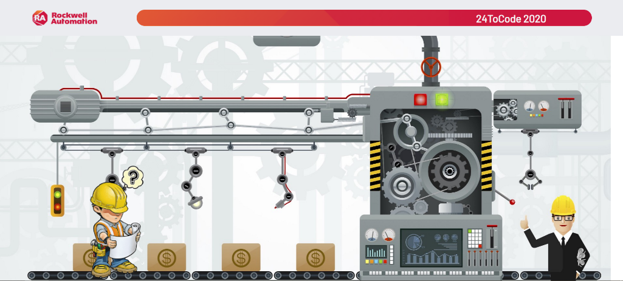
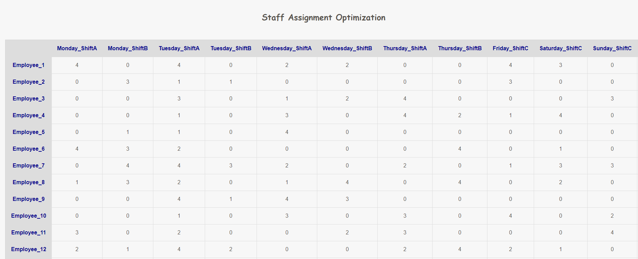
Solution: Design & Demonstration
Rockwell Imachination
Live demonstration

Slide 4




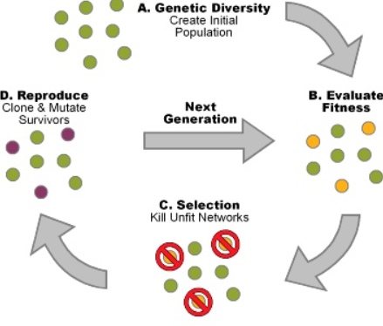


Solution: Technologies & Strategy
Rockwell Imachination
Notes:
Use this space as a bookend to your live demonstration. Highlight the technologies that were featured in your solution and why. Also, speak to the new technologies that your team learned during this event.
Suggested time: 30 seconds

Slide 5
Questions
& Answers
Notes:
This slide will be shown after your live demo and during the Q&A session. Feel free (and be prepared) to jump back into your demo if the Q&A session deems it necessary.
Suggested time: 2 minutes total (including demonstration)

